Slide 1
Training a Quadruped Walker
Made By:
Swati Singh
Shweta Pandey
Geeta
SUPERVISED BY:
Prof. Manish Gaur
Dr. Jaswant Kumar

Slide 2
Objective :
To train custom-build Quadruped Walker through various reinforcement learning algorithms. The walker agent is incentivized to navigate towards a target while being restricted to two or three degrees of freedom along each of its limbs.
To clarify more, we are training a bot in a virtual environment to adapt and react to the obstacles met in that environment.

Slide 3
Tools and Technologies Used:
Pybullet - pybullet is an easy to use Python module for physics simulation, robotics and deep reinforcement learning based on the Bullet Physics engine.
It provides forward dynamics simulation, inverse dynamics computation, forward and inverse kinematics and collision detection and ray intersection queries.
Collision shapes include: sphere, box, cylinder, cone, non-convex and triangle mesh.
Other libraries – numpy, torch, gym, os, matplotlib, etc.
Platform - Google colab

Slide 4
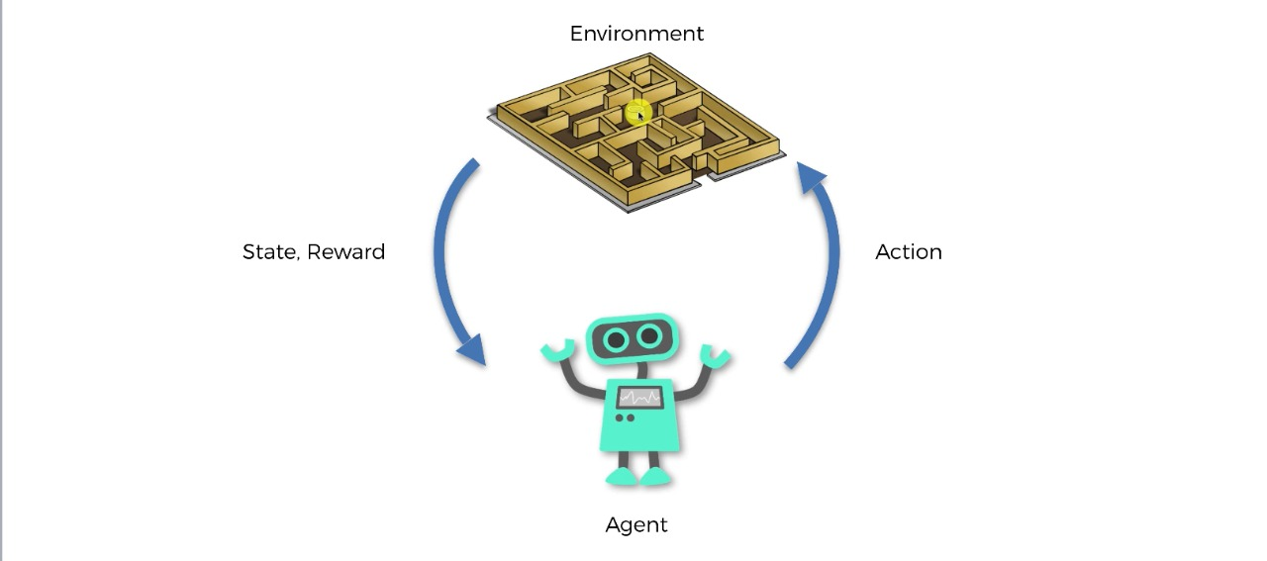
Reinforcement Learning :
Reinforcement Learning is a feedback-based Machine learning technique in which an agent learns to behave in an environment by performing the actions and seeing the results of actions. For each good action, the agent gets positive feedback, and for each bad action, the agent gets negative feedback or penalty.
Agent(): An entity that can perceive/explore the environment and act upon it.
Environment(): A situation in which an agent is present or surrounded by. In RL, we assume the stochastic environment, which means it is random in nature.
Action(): Actions are the moves taken by an agent within the environment.
State(): State is a situation returned by the environment after each action taken by the agent.
Reward(): A feedback returned to the agent from the environment to evaluate the action of the agent.

Slide 5
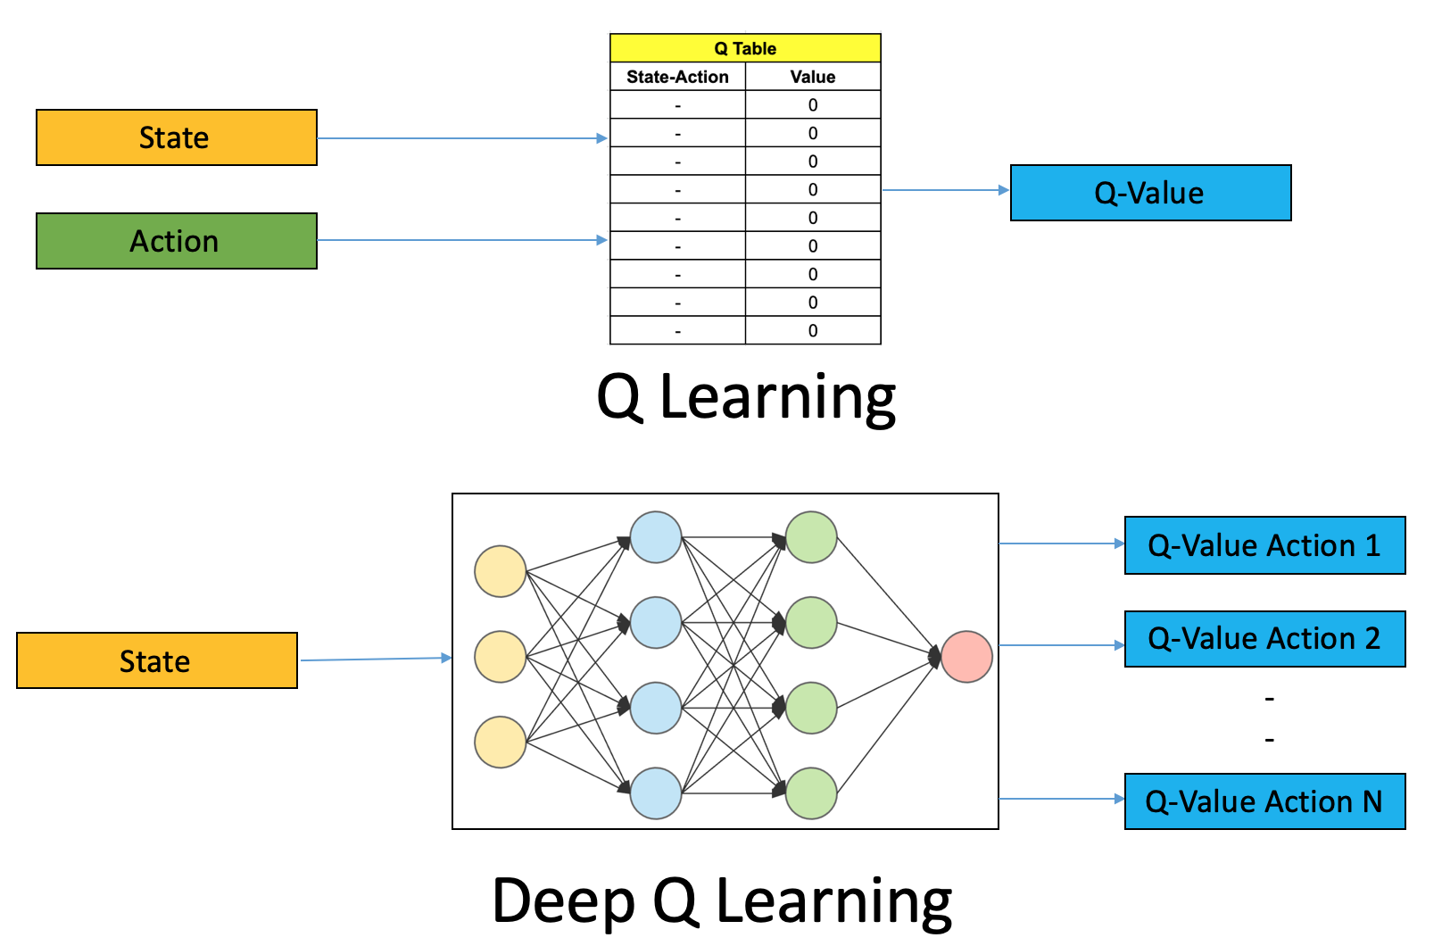
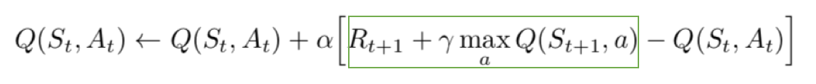
Deep Q-Learning :
In deep Q-learning, we use a neural network to approximate the Q-value function. The state is given as the input and the Q-value of all possible actions is generated as the output.
The steps involved in reinforcement learning using deep Q-learning :
All the past experience is stored by the user in memory
The next action is determined by the maximum output of the Q-network
The loss function here is mean squared error of the predicted Q-value and the target Q-value – Q*.

Slide 6
Policy Gradient :
Policy gradient is an approach to solve reinforcement learning problems.
The goal of reinforcement learning is to find an optimal behavior strategy for the agent to obtain optimal rewards. The policy gradient methods target at modeling and optimizing the policy directly. The policy is usually modeled with a parameterized function respect to θ, πθ(a|s). The value of the reward (objective) function depends on this policy and then various algorithms can be applied to optimize θ for the best reward.
Like any Machine Learning setup, we define a set of parameters θ (e.g. the coefficients of a complex polynomial or the weights and biases of units in a neural network) to parametrize this policy — π_θ​ (also written a π for brevity).

Slide 7
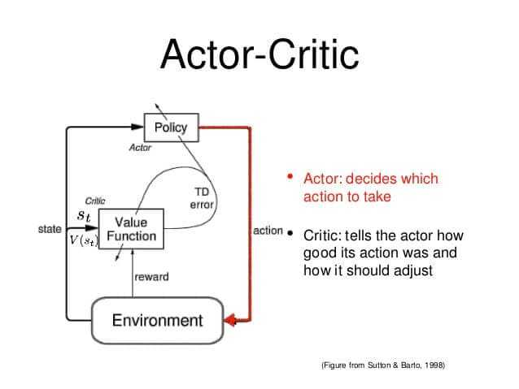
Actor Critic Model :
It has two networks: Actor and Critic. The actor decided which action should be taken and critic inform the actor how good was the action and how it should adjust. The learning of the actor is based on policy gradient approach. In comparison, critics evaluate the action produced by the actor by computing the value function.
The principal idea is to split the model in two: one for computing an action based on a state and another one to produce the Q values of the action.
The actor takes as input the state and outputs the best action. It essentially controls how the agent behaves by learning the optimal policy (policy-based). The critic, on the other hand, evaluates the action by computing the value function (value based).

Slide 8
Deep Deterministic Policy Gradient
DDPG is a model-free off-policy actor-critic algorithm that combines Deep Q Learning(DQN) and DPG. Original DQN works in a discrete action space and DPG extends it to the continuous action space while learning a deterministic policy.
As it is an off-policy algorithm, it uses two separate policies for the exploration and updates. It uses a stochastic behaviour policy for the exploration and deterministic policy for the target update.
DDPG is an actor-critic algorithm; it has two networks: actor and critic. Technically, the actor produces the action to explore. During the update process of the actor, TD error from a critic is used. The critic network gets updated based on the TD error similar to Q-learning update rule.
We did learn the fact that the instability issue that can raise in Q-learning with the deep neural network as the functional approximator. To solve this, experience replay and target networks are being used.

Slide 9
DDPG continued….
In DDPG, function approximation errors are known to lead to overestimated value estimates, suboptimal policies and divergent behaviour.
Also, due to the slow-changing policy in an actor-critic setting, the current and target value estimates remain too similar to avoid maximization bias. So we improved the DDPG, to an actor-critic format by using a pair of independently trained critics and to address the coupling of value and policy, we delayed policy updates until the value estimate has converged which is called Twin-Delayed Deep Deterministic Policy Gradient.
Hence, here the word “Twin” represents the two independent critic model and target model and the “Delayed” represents the delaying of policy updates.

Slide 10
Twin-Delayed Deep Deterministic Policy Gradient :
Twin Delayed Deep Deterministic Policy Gradient Algorithm (TD3) is an Deep Reinforcement Learning algorithm which concurrently learns a Q-function and a policy. It is an actor-critic algorithm which considers the interplay between function approximation error in both policy and value updates. It uses Actor Critic approach where Actor function specifies action given the current state of the environments. Critic value function specifies a signal (TD Error) to criticize the actions made by the actor.
There are two objectives of the algorithm:
Minimize the Critic loss which is sum of mean squared error between Q value of target Critic and the two Critics. Here Gradient descend is used for updating parameters of Critic Network
Maximize the performance of Actor. Here Gradient ascent is used for updating parameters of the Actor network

Slide 11
Implementation of TD3
Step1: We have initialized the Experience Replay memory which will store past transitions from which the critic models will learn the Q-values.
Step2: We have built one neural network for the Actor model and one for the Actor target.
Step3: We then built two neural networks for the two Critic models, and two neural networks for the two Critic targets.
Step4: Sample a batch of transitions (s,s’,a,r) from the memory. Then for each element of the batch: from next state s’, The actor target plays the next action a’.

Slide 12
Step5: We then add Gaussian noise to the next action a’. Adding the Gaussian noise encourages exploration, and avoids the agent from getting stuck to one state, and potentially avoiding a bad state.
Step6: The two Critic Targets each take the couple (s’,a’) as input and return two Q- values: Qt1(s’,a’) and Qt2(s’,a’) as outputs.
Step7: We find the minimum of these two Q-values which represents the approximated value of next stage.
Step9: We get the final target of two critic models as Qt.
Step10: The two Critic models take each the couple (s,a) as input and return two Q-values Q1(s,a) and Q2(s,a) as outputs.
Step11: We compute the loss coming from the two critic models i.e. critic loss.

Slide 13
Step12: We backpropagate the Critic loss and update the parameters of the two Critic Models with an SGD optimizer
Step13: Once every two iterations, we update the Actor Model by performing gradient ascent on the output of the first Critic Model.
Step14: Still Once every two iterations, we update the Actor Target by Polyak averaging.
Step15: Once every two iterations we update the Critic Target by Polyak averaging
The word "Delayed" refers to the fact that every other iteration, the update of the Actor Model, Actor Target, and the two Critic Targets is postponed, i.e., an update is only made every two iterations. In comparison to the DDPG model, this delay results in an improvement.

Slide 14
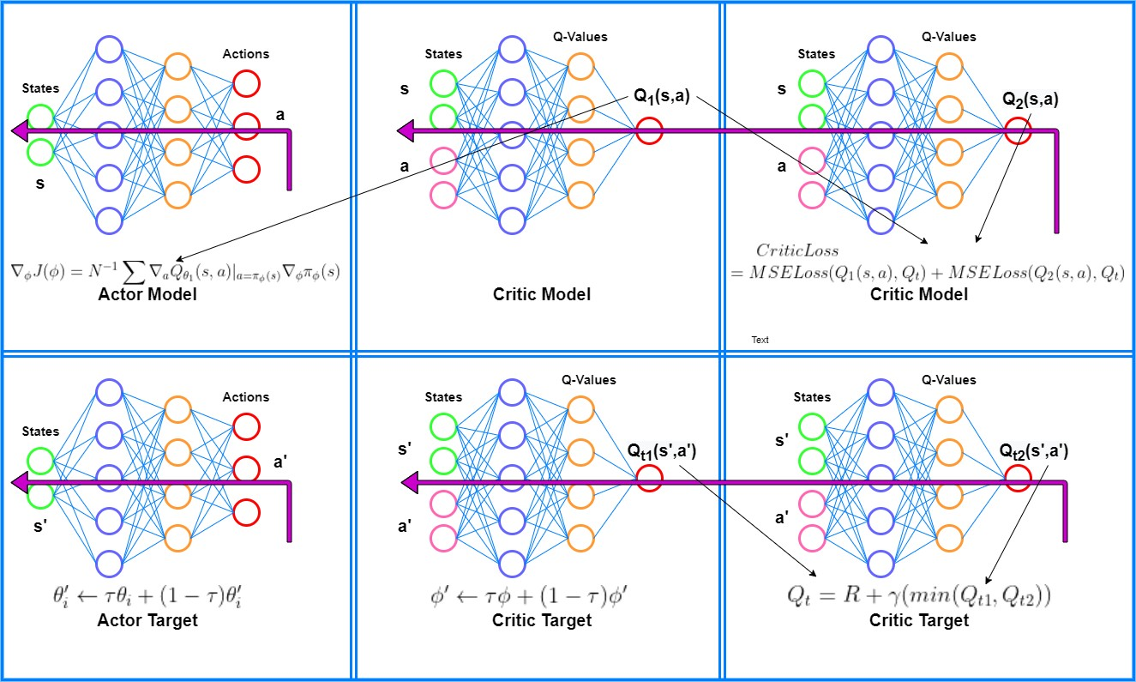

Slide 15
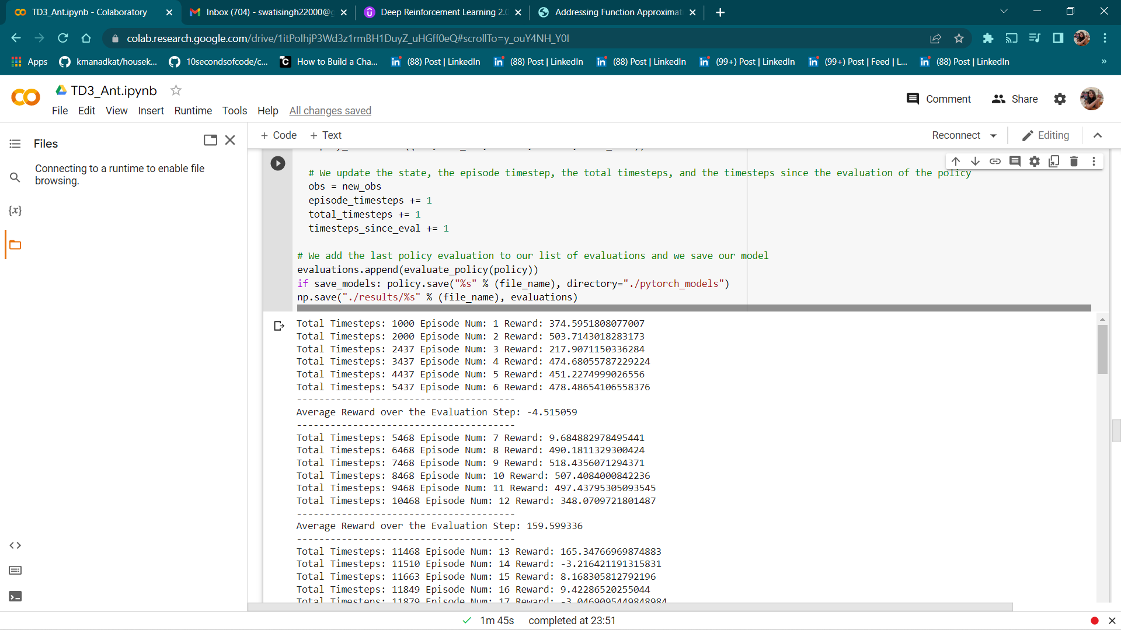
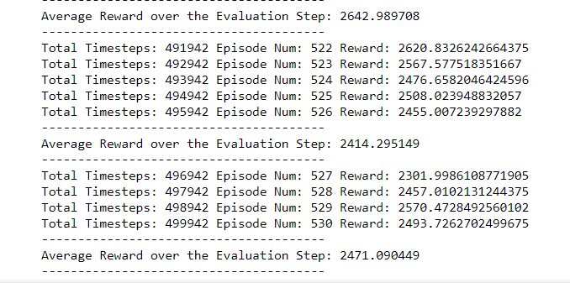

Slide 16
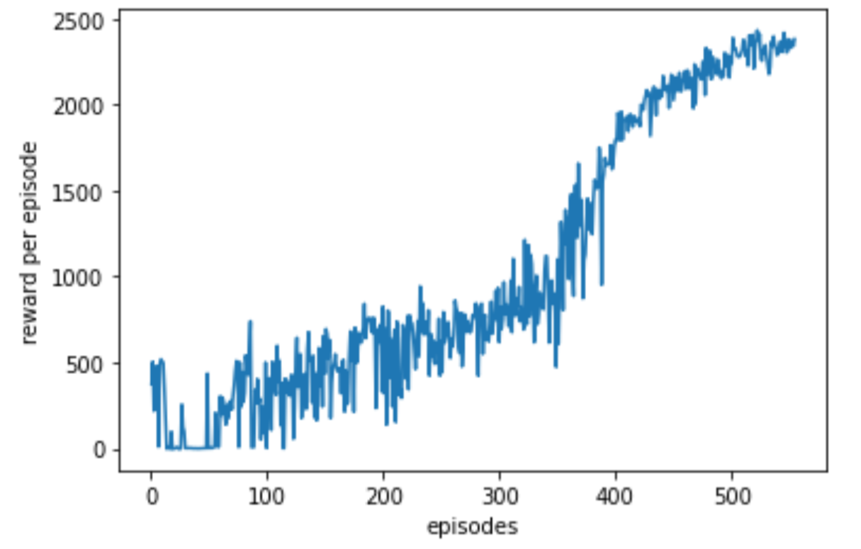
Performance of the TD3-Ant

Slide 17
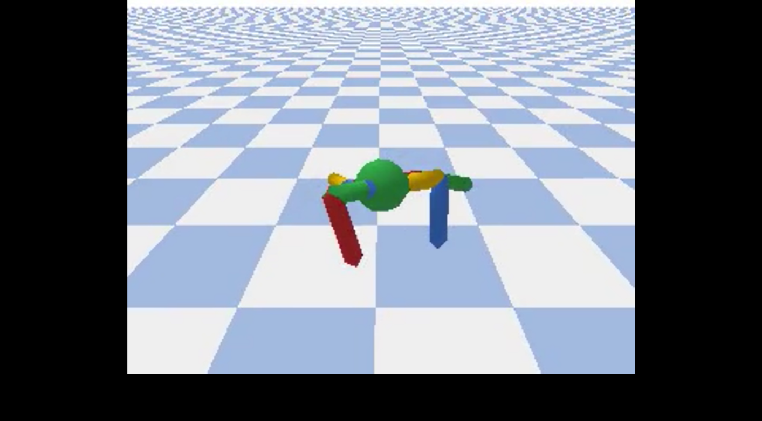
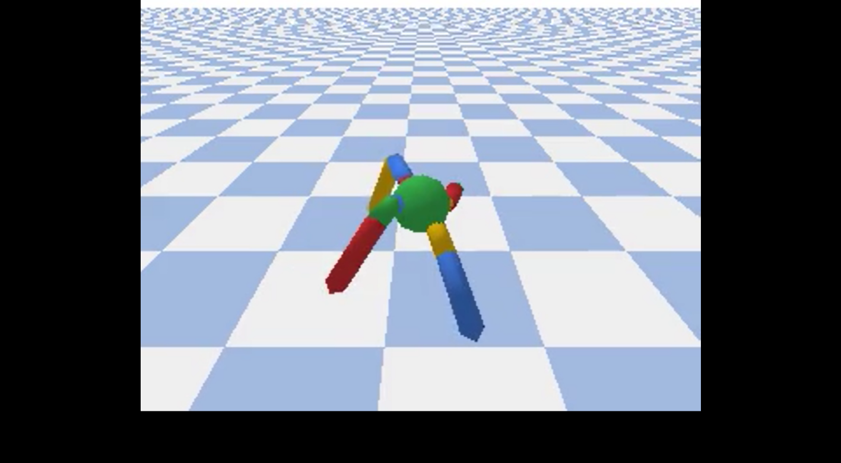
Stepwise movements of TD3-Ant
Below is the snapshot of walker after execution of 10,000 timesteps:
Below is the snapshot of walker after 50,000 timesteps:

Slide 18
Conclusion
With the implementation of TD3PG we can conclude that we have fulfilled our objective, that is, we have successfully trained our walker in Ant-v1, Half-cheetah-v1, and Half-humanoid-v1 environment. Based on the training results the agent was able to successfully navigate the environment.
The approximate value of the average reward received after training the walker is equivalent to the return value mentioned in the publication.
Hence, we confirmed the usefulness of the TD3 algorithm in coordinating the motion of a Quadruped Walker in a continuous action-space with this implementation.
.

Slide 19
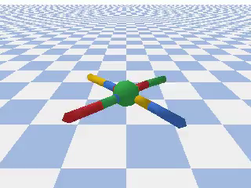

Slide 20
THANK YOU

